Slide 1
Sidecar Authentication For Reliable Microservices
> Ran Xu / Verda Platform Development Infrastructure Engineer
Notes:
Hello, everyone. My name is Ran Xu. I am an infrastructure Engineer of Verda Platform Team in LINE. Our team together with Network Team and SRE Team are in charge of LINE Private Cloud platform
Over the past one year, more and more line core services are migrated to private cloud platform. In that case, we faced various challenges such as scale issues, performance issues, and reliability issues.
Today, I will talk about one reliability issues of the identity service we encountered inside the LINE private cloud platform and share how we think about this issue and how we resolve it.

Slide 2
About Me
Ran Xu (littledriver)
Joined LINE in 2019/09
Infrastructure Engineer Of Managed Kubernetes Service
Notes:
First of all, I would like to introduce myself. I joined LINE in Sep 2019. I was responsible for developing and maintaining LINE Managed Kubernetes Services platform. And I am also in charge of reliability improvement work within my team.

Slide 3
Introduction Of Verda ( LINE Private Cloud Platform )
Outage Case Study: Verda Identity Service
Analysis Of Identity Outage Case
Improvement Plan Of Identity Service
Agenda
Notes:
Here is the agenda of my topic today
first of all, I will introduce the architecture of LINE Private Cloud Platform
second, I will also introduce two actual outages of the Identity service
third, I will share analysis result of both outages
finally, I will share how we improve our Identity service
1min32s

Slide 4
Verda — LINE Private Cloud Platform

Slide 5


Verda Family
Platform Service
Function Service
PaaS
Managed
Database
Managed
Kafka
Managed
Kubernetes
WebUI
Managed
Service
API
Load Balancer
CDN
Object Storage
Block Storage
IaaS
Identity
VM
Bare
metal
DNS
User Interface
Backend Components
Notes:
Verda is the LINE private cloud platform. It's responsible for providing reliable infrastructure service to LINE developers at a low cost. Verda Platform includes two parts
- User Interface
A set of backend infrastructure services
For user interface part, we provided two types of interface
- Restful API
- WebUI
Through this API and WebUI, we expose backend infra services inside the verda to LINE developers by hiding unnecessary tech details so that they can use them conveniently.
==============
For backend infrastructure services, it is separated by 3 layers
The first layer is IaaS layer. It provides several fundamental IaaS services to LINE developers, like Loadbalancer, block storage and VM
=====================
The second layer is managed service layer. It provides Managed Middleware Services using IaaS layer services. This service allows LINE developers to use Middleware without having to know the details of each Middlewar, like Verda Managed Kubernetes Service
===========================
The third layer is PaaS service layer. It provides some platform services to LINE developers , like Function service and CI/CD pipeline
In the architecture graph, one of most important services is identity service in IaaS layer. In Verda, we customize Keystone, the openstack identity serivce to provide API client authentication and service discovery functionalities to LINE developers and internal Verda Infra services. Almost all products that verda provides need it.
2 min 20s

Slide 6
Outage Case Study Of Identity Service
Notes:
As I mentioned, more and more LINE developers start to deploy their services on Verda .More applications usually mean much pressure on platform side. In past 6 months, we encountered two big outages of identity service inside the verda.
So, now, let me introduce what it is and what we learn from them

Slide 7
Outage Case Study Of Identity Service
Issue
Impact
Workaround
Root Cause
Notes:
I will introduce them from the 4 perspectives as below
Issue
Impact
Workaround
Root Cause

Slide 8
Identity Service (Keystone) Is Down Due To Malicious Client Requests
Notes:
The first outage happened on March this year

Slide 9
OUTAGE-2021-03
Issue
Keystone service cannot handle the any request normally and looks like stuck
Impact
Infra Service Inside the Verda Platform that relies on Keystone Service are dowAdd your Text
Workaround
Restart keystone and Apache server
Root Cause
?
Notes:
The issue we countered is: keystone service is stuck. it cannot handle any request, include the token issue and token validation request normally
The impact is pretty huge, as I mentioned, almost all infra verda service we provided rely on the authentication functionality (token issue / validation) . So they cannot serve for LINE developers normally during the keystone is down
Because of the serious impact, we try to restart keystone a to recover this issue first. It works temporarity. But it reminds us, our keystone service was in a high reliability risk, it may breaks all verda infra service anytime. Once we confirmed the service is recovered, we start investigation at once.
For locate the root cause, first of all, we recall what's expected behaviour of handling a request in keystone side. Then, we try to detect the actual behaviour and compare it with the expected one to find if there is any difference, so that we can locate the root cause based on it.
2 min 12
2min55

Slide 10

Expected Keystone Request Handling Flow
HTTP Request
Pre-Folk WSGI Server
Load & Start App
Keystone Service
Keystone WSGI-Server
Keystone WSGI-APP
Apache mod_wsgi
webob
Get /v3/auth
Apache Web Server
Keystone WSGI-Server
Keystone WSGI-APP
Apache mod_wsgi
webob
Keystone WSGI-Server
Keystone WSGI-APP
Apache mod_wsgi
webob
Notes:
Here is the expected request handling flow in keystone side. You can see, a keystone service usually includes 3 parts:
Apache Web Server. It is responsible for receiving HTTP request from LINE developer or LINE infra
Pre-Folked worker process. It was pre-folked by apache server after it started for handing keystone HTTP request. Each worker runs the keystone wsgi server that is implemented by Apache using the mod_wsgi library
Keystone wsgi applications. Each keystone wsgi server will run a keystone wsgi application. Keysgtone use webob package to make Keystone business logic be able to expose as a "WSGI application"
So, when the token validation or token issue request comes to keystone service, it will go to the keystone wsgi-app through this flow and proceed the corresponding business logic. The related response will be returned through this flow in reversed order.
(7min28s should pass)
Now, let’s check what’s actual behavior

Slide 11

Actual Keystone Request Handling Flow
HTTP Request
Pre-Folk WSGI Server
Load & Start App
Response: 'HTTP/1.1 500 Internal Server Error
Date: Sun, 23 May 2021 14:21:12 GMT
Server: Apache
Cache-Control: private, max-age=0, must-revalidate
Content-Length: 527
Connection: close
Content-Type: text/html; charset=iso-8859-1\r\n\r\n<!DOCTYPE HTML PUBLIC "-//IETF//DTD HTML 2.0//EN">\n<html><head>\n<title>500 Internal Server Error</title>………</html>’
[Error]hit timeout: 20.0556459427 sec passed
Keystone Service
Keystone WSGI-Server
Keystone WSGI-APP
Apache mod_wsgi
webob
Get /v3/auth
Apache Web Server
Keystone WSGI-Server
Keystone WSGI-APP
Apache mod_wsgi
webob
Keystone WSGI-Server
Keystone WSGI-APP
Apache mod_wsgi
webob
Notes:
First, we checked logs of apache server, we found requests that cause the keystone is stuck have similar traits:
- The value of content length is greater than the actual size of request body
- each bad request is gave up by apache server after 20 secs. The 20secs is the default read request body timeout settings in apache web server side

Slide 12

Actual Keystone Request Handling Flow
HTTP Request
Pre-Folk WSGI Server
ERROR keystone.common.wsgi [req-63ca9bf4-139c-4d76-9db4-3b1c26c7749d - - - - -] request data read error
ERROR keystone.common.wsgi Traceback (most recent call last):
ERROR keystone.common.wsgi File "/usr/lib/python2.7/site-packages/keystone/common/wsgi.py", line 434, in __call__
ERROR keystone.common.wsgi response = self.process_request(request)
ERROR keystone.common.wsgi File "/usr/lib/python2.7/site-packages/keystone/middleware/core.py", line 89, in process_request
ERROR keystone.common.wsgi params_json = request.body
ERROR keystone.common.wsgi File "/usr/lib/python2.7/site-packages/webob/request.py", line 701, in _body__get
ERROR keystone.common.wsgi self.make_body_seekable() # we need this to have content_length
ERROR keystone.common.wsgi File "/usr/lib/python2.7/site-packages/webob/request.py", line 943, in make_body_seekable
ERROR keystone.common.wsgi self.copy_body()
ERROR keystone.common.wsgi File "/usr/lib/python2.7/site-packages/webob/request.py", line 966, in copy_body
ERROR keystone.common.wsgi self.body = self.body_file.read(self.content_length)
ERROR keystone.common.wsgi File "/usr/lib/python2.7/site-packages/webob/request.py", line 1542, in readinto
ERROR keystone.common.wsgi data = self.file.read(sz0)
ERROR keystone.common.wsgi IOError: request data read error
Load & Start App
Keystone Service
Keystone WSGI-Server
Keystone WSGI-APP
Apache mod_wsgi
webob
Get /v3/auth
Apache Web Server
Keystone WSGI-Server
Keystone WSGI-APP
Apache mod_wsgi
webob
Keystone WSGI-Server
Keystone WSGI-APP
Apache mod_wsgi
webob
Notes:
Second, by checking logs of keystone wsgi-app, we also found, it always waits for the data inside the request body after it confirmed the expected content length.
But, no any data is sent, so in that case, one global level exception is posted.
Because this exception isn't handled well in keystone wsgi app side, it causes the whole keystone wsgi application is down. The corresponding exception is also shown in wsgi server side

Slide 13

Actual Keystone Request Handling Flow
HTTP Request
Pre-Folk WSGI Server
mod_wsgi (pid=73664): Unable to get bucket brigade for request.
mod_wsgi (pid=73664): Unable to get bucket brigade for request.
mod_wsgi (pid=73664): Unable to get bucket brigade for request.
mod_wsgi (pid=72590): Exception occurred processing WSGI script '/usr/bin/keystone-wsgi-public'.
mod_wsgi (pid=72586): Exception occurred processing WSGI script '/usr/bin/keystone-wsgi-public'.
IOError: failed to write data
IOError: failed to write data
Load & Start App
Keystone Service
Keystone WSGI-Server
Keystone WSGI-APP
Apache mod_wsgi
webob
Get /v3/auth
Apache Web Server
Keystone WSGI-Server
Keystone WSGI-APP
Apache mod_wsgi
webob
Keystone WSGI-Server
Keystone WSGI-APP
Apache mod_wsgi
webob

Slide 14
Expected Keystone Request Handling Flow
HTTP Request
Pre-Folk WSGI Server
Load & Start App
Keystone Service
⌛
Keystone WSGI-Server
Keystone WSGI-APP
Apache mod_wsgi
webob
Get /v3/auth
Apache Web Server
Keystone WSGI-Server
Keystone WSGI-APP
⌛
Apache mod_wsgi
webob
⌛
Keystone WSGI-APP
Keystone WSGI-Server
Apache mod_wsgi
webob
Notes:
after that, the root cause is more clear in our head.
Because apache uses the mod-wsgi to implmenet wsgi server that will pre-folk several worker process to load and start the keystone wsgi app. The default setting of number of this worker process is 3 in our dev env.
Each worker process in here cannot handle the lots of requests at the same time. So, when the malicious request above come in, it's easy to make 3 work processes busy, the keystone cannot handle any new request anymore and it looks like “hang"
we think that's why our workaround "restart apache wsgi server" can recover this issue

Slide 15
OUTAGE-2021-03
Issue
Keystone service cannot handle the token issue and token validation request normally
Impact
Infra Service Inside the Verda Platform that relies on Keystone Service are dowAdd your Text
Workaround
restart keystone and Apache server
Root Cause
Keystone WSGI application is down due to malicious requests. And it isn’t re-executed by Keystone WSGI server.
Notes:
Now, we got the root cause of this outage
9min31

Slide 16
Keystone Service Is Down Due Requests Exceed Service Processing Capacity
Notes:
This second outage happened on May this year.

Slide 17
OUTAGE-2021-05
Issue
Keystone service cannot handle the any request normally and looks like stuck
Impact
Infra Service Inside the Verda Platform that relies on Keystone Service are dowAdd your Text
Workaround
?
Root Cause
?
Notes:
The issue we countered in this outage is similar with previous one: keystone service cannot handle the token issue and token validation request normally.
The impact is also same: almost all verda services cannot serve for LINE developers normally
Because the issue is similar with the previous one. For avoid the further damage, we try to recover this issue by previous workaround: restart keystone and apache server. But It doesn’t work. It let us feel the root cause of this outage is little different

Slide 18
OUTAGE-2021-05 — Troubleshooting
Issue
Keystone service cannot handle the token issue and token validation request normally
Impact
Infra Service Inside the Verda Platform that relies on Keystone Service are dowAdd your Text
Workaround
?
Root Cause
?
Notes:
As I mentioned, the issue in malicious request that causes the previous keystone outage is content-length is greater than the actual size of request body.
In this outage, the root cause is related to the number of concurrent requests arriving at the keystone service at the same time. Here are some evidences we detected from the grafana dashboard

Slide 19
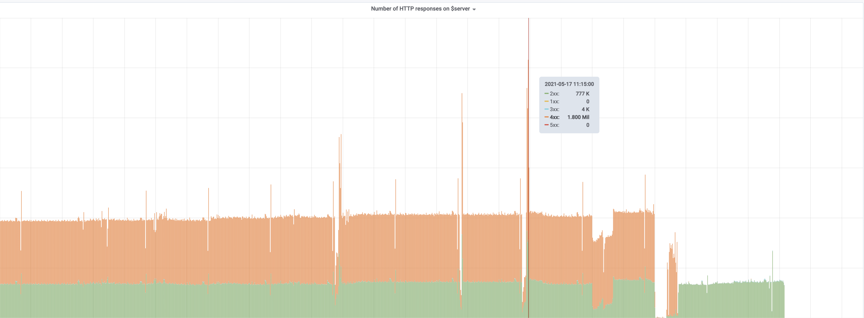
OUTAGE-2021-05 — Troubleshooting
The 2.5M req / 15mins = 2,777 req / s came to the 3 keystone nodes
Authentication API Latency 33ms / req
Max Keystone QPS = 33 (req/s) * 12 (processes/node) * 3 (node) = 1,188 req/s
Notes:
We detected 2.5 million request come to the keystone service during the 15mins time window, it means the QPS of keystone service in that time is around 2777 req / sec
Normally, for each authentication request, the API latency is 30ms. It means, for the each keystone wsgi app, the maximum QPS is 33 request / s
So, if Each keystone service folks 12 worker process to start the keystone wsgi server. The replica of keystone service is 3 in that time. It means the maximum number of request that keystone service can handle is 33 * 12 * 3 = 1188 req / s
But the current nunmber of request already exceed the capacity of keystone service

Slide 20
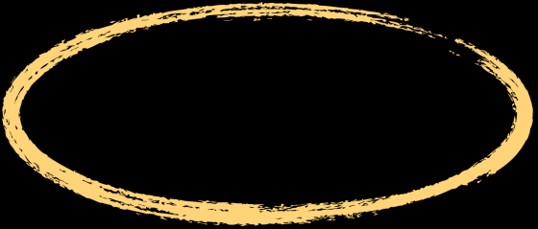
OUTAGE-2021-05 — Troubleshooting
{“duration”:"33.910ms","level":"info","method":"GET","msg":"access-log","path":"/v3/auth/tokens","requestID":"3fd49e24-18f2-4a61-8520-8ff42f5797c9", “User-Agent”: “vks-gw-api”,“status”:200,”time”:”9999-99-99T16:51:37.681Z”}
Notes:
Then, we try to confirm where those requests come from? After we checked the audit log of keystone service, we found the huge number of authentication request come from the same client, it is verda managed kubernetes service.

Slide 21
OUTAGE-2021-05
Issue
Keystone service cannot handle the token issue and token validation request normally
Impact
Infra Service Inside the Verda Platform that relies on Keystone Service are dowAdd your Text
Workaround
?
Root Cause
A large number of token validation requests from Verda Managed Kubernetes to keystone service exceed the handling ability of keystone service
Notes:
Root Cause
So, the root cause is clear now.
A large number of token validation requests from Verda Managed Kubernetes. It exceeds the handling ability of keystone service. In that case, almost all worker process in keystone side are occupied by Verda Managed Kubernetes. Requests from other clients cannot be handled normally

Slide 22

OUTAGE-2021-05
New Keystone Service
Apache Web Server
Old Keystone Service
Apache Web Server
Notes:
Workaround
For the workaround,
Because of the serious impact of this issue, after we located the root cause, we deploy a totally new keystone service and require members of verda managed kubernetes service team to change the keystone endpoint they are using. And the issue on original keystone is gone. Another verda infra services is also recovered
13min 30s passed in here

Slide 23
Analysis Of Identity Outage Case
Notes:
By knowing the issue and impact on previous outages. There is no doubt we have to find a fundamental way to improve it. Before we take any action, we want to analyze previous outages so that we can identity what's real problem behind of them
.

Slide 24
Analysis Of Identity Outage Case
Architecture
Dependence
Notes:
I will share our analysis result from 2 perspectives
dependence
architecture

Slide 25
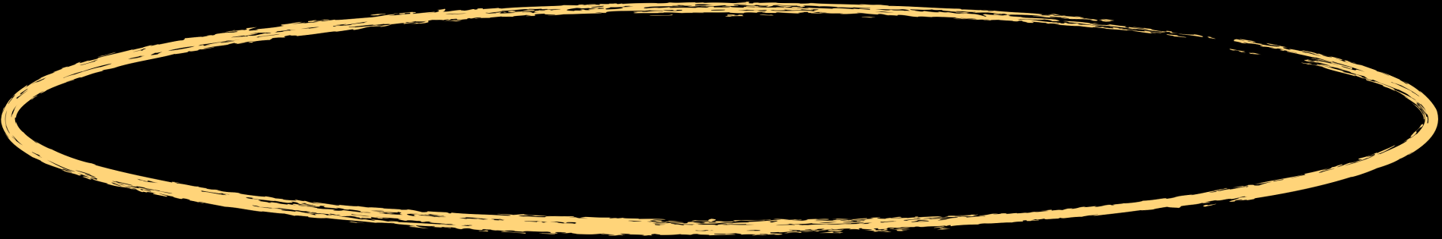
Architecture — Keystone Request Distribution
Almost all requests that comes to the Keystone service are related to authentication (token issue/token validation), within each 15mins time window
Around 99.95 % of the load on keystone service are token validation, only 0.05 % request are token issue, within each15mins time window
Notes:
When we checked the request distribution situation of keystone service, two observations we got
Almost all requests that comes to the keystone service within 15mins time window are related to authentication (token issue/token validation)
Around 99.95 % of the load on keystone service are token validation, only 0.05 % request are token issue

Slide 26


Architecture — Keystone Request Distribution
Keystone Service
Token Validation
Token Issue
Apache Web Server
Service Discovery
Others
Notes:
First observation indicates one fact to us: authentication functionality of the keystone service is the most used functionalities. But, authentication is just one of functionalities that keystone service provides, there are still others, like service discovery.

Slide 27
Architecture — Keystone Patch Distribution
Past 3 Years
15
3
0
Custom Patches
Upstream Patches
Authentication Patch
Notes:
Then, we also checked the patches of LINE custom keystone, we found all patches we added to keystone are related special business logic that are only for LINE internally. Token business logic has never been updated for more than 3 years.
It lets us feel the authentication -- important and most used function of keystone service is taking unnecessary and extra reliability risk from our custom business logic.

Slide 28
Architecture — Token Issue & Token Validation
Almost all requests that comes to the Keystone service are related to authentication (token issue/token validation), within each 15mins time window
Around 99.95 % of the load on keystone service are token validation, only 0.05 % request are token issue, within each15mins time window
Notes:
According to the second observation, we found the token validation is most used feature compared with token issue . In that case, when token issue has something wrong, token validation shouldn’t be affected

Slide 29
Architecture — Tech Direction
Decouple authentication functionality from the original Keystone
Around 99.95 % of the load on keystone service are token validation, only 0.05 % request are token issue, within each15mins time window
Notes:
So, for architecture issue, it seems like authentication logic is coupled with other custom business logic. And their lifecycle is totally different. In that case, what we would like to do is decouple them into different keystone deployment workload. One is only responsible for authentication, another one is for left functionalities
====
But, even if we decouple authentication and original keystone service. It seems like "coupling issue" also exists inside the authentication functionality.
But, as you see, token issue and token are just features of authentication functionality. Decouple a service into too many micro services is not good idea due to it will increase the complexity of service management. Let's keep it in our mind first.

Slide 30

Dependence — Verda Infra Service ↔ Keystone Service
VKS Validation
Token Validation
VFS Validation
Token Issue
Apache Web Server
VBS Validation
Service Discovery
VOS Validation
Others
Notes:
One dependency serious issue we found is: all components depend on keystone service. Once keystone service is down, it causes other components are also down. Although, make each service inside our platform independent completely is impossible. It doesn't mean we should stop in here. Any little improvement for reducing the unnecessary dependency between different services is valuable.

Slide 31
Dependence — Tech Direction
Token Validation
VKS Validation
Token Validation
VFS Validation
Token Validation
Token Issue
Apache Web Server
Token Validation
VBS Validation
Service Discovery
Token Validation
VOS Validation
Others
Notes:
Because we already knew, the token validation is the most used feature by other infra service. If we can move the token validation part from server (keystone) side to each client side, we could reduce the huge part of unnecessary dependency staff between infra services and keystone service. After that, the token validation load of keystone service will also be decreased dramatically.
18 mins passed

Slide 32
Improvement Plan Of Identity Service
Notes:
After we finalized the improvement idea, let me share with you how we make it happen one by one

Slide 33

Improvement Plan Of Identity Service
Decouple
Stateless Token Validation
Decouple Authentication From Keystone
Implement Stateless Token Validation In Edge Side
Notes:
First improvement we want to do is decouple authentication functionality from keystone service

Slide 34
Decouple Authentication From Keystone
Deployment Workload
Nginx-Ingress Controller
Apache Web Server
Ingress-Keystone
Load Balancer
Keystone WSGI-Server
Service
Ingress-Nova
Apache mod_wsgi
Keystone WSGI-APP
webob
Notes:
Before we did any actual work, let's see how the keystone is deployed currently in verda.
Keystone itself is deployed using the deployment workload. Necessary configuration of keystone, like apache server configuration, is stored in configMap and encrypted secret resource. In front of keystone deployment, k8s service and ingress-controller are located in there. Beside, there is the loadbalancer that is deployed in front of ingress-controller. So, when the request comes to keystone service, it will go though loadbalancer, ingress-controller, then ingress-controller will distribute the request based on API path on L7 layer to keystone k8s service. Finally, it will go to one of keystone pod.
===========
According to the current architecture, the decouple work can be separated into two phases
first phase: clone a keystone service that only serves for authentication request. Then creating the corresponding k8s service of the new deployment for load balance request to each backend keystone pod. Finally, we can add a new rule to the ingress resource, distribute the authentication request whose API path prefix is `/v3/auth` to the new keystone service.
second phase: remove all unnecessary logic except authentication of keystone service from the code perspective. not only decouple them from architecture perspective, but also decouple them from the implementation perspective.
For reducing the serious impact of keystone outages, we prefer to proceed the first phase.

Slide 35
Deployment Workload
Nginx-Ingress Controller
Apache Web Server
Ingress-Keystone-Auth
WSGI Server
Get /v3/auth/tokens
WSGI APP
Service
Deployment Workload
Ingress-Keystone-Others
Apache Web Server
WSGI Server
WSGI APP
Notes:
After the first phase is finished, the architecture should be like below
The authentication request will be forwarded into the new keystone deployment. Other requests will be forwarded to original one

Slide 36
Improvement Plan Of Identity Service
Decouple
Stateless Token Validation
Decouple Authentication From Keystone
Implement Stateless Token Validation In Edge Side
Notes:
Second improvement we would like to do is moving token validation staff on edge side and re-implement it in stateless way.

Slide 37
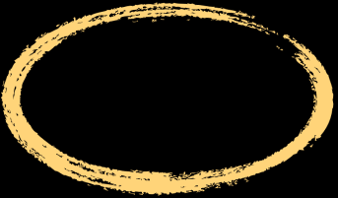
Token Issue
Fernet Token Version
Current Timestamp
Initialization Vector
Cipher Text
HMAC
Token Payload:
Fernet key
Version / UserID / Method / Project ID / Expiry Time / Audit ID
Notes:
If we want to re-implement the stateless token validation feature in edge side, we should know how a token of keystone is generated and how it is validated first. In our env, keystone uses the fernet token as token provider.
One fernet token generation needs several thing. Two things are very important
- Cipher Text: It's the combination of token issue payload and some padding characters.
fernet key: You don't need to know too much about fernet key in here , just understand it as a general private key that is ususlly used in encryption/decryption area.
keystone will encrypt the token payload with fernet key and combine with other parts, and sign it with HMAC key. Then, we got one fernet token

Slide 38
Token Validation
GET 'https://verda-stage-dev-keystone.linecorp-dev.com:5000/v3/auth/tokens' \
--header 'Content-Type: application/json' \
--header 'X-Auth-Token: <A valid authentication token for an administrative user> ' \
--header 'X-Subject-Token: '<the token that you want to validate> \
InValidate
Token Payload:
Fernet key
Fernet key
Version / UserID / Method / Project ID / Expiry Time / Audit ID
HMAC
Validate
Notes:
For the token validation: let’s see the request payload of token validation
After keystone received this request
first, it will uses the fernet key to decrypt the token that is in X-Subject-Token http header
second, it will compare the expired time of token with current timestamp. If it is already expired, return an error about "token not found”
third, it will check if the token is already revoked. If its is, return an error about "token not found"
otherwise, it will return identity info related to this token, like scope, domain and expiredtime to clients
After we knew how token issue and token validation works, let’s talk about how we improve the token validation

Slide 39
Stateless Token Validation On Edge
Store Fernet key safely and share it with clients
Find a good way to inject token validation logic without intrusion for client code
Notes:
If you recall the token validation process, the key point is the fernet key. Once we can get this fernet key and decrypt the payload, all we need to do is just checking if they are already expired or not by comparing the timestamp.
So, if we want make token validation as stateless and do it on edge side
We should store the fernet key in a safe place and it can be shared with keystone and other clieent that needs to do token validation staff
We also should find a good way to inject this token validation logic without intrusion for client implementation
========
Because, we already deployed the keystone in our internal kubernetes cluster. The most direct way of sharing the fernet key is storing it in a encrypted secret resource. The private key that is used for encrypting fernet key will be rotated periodically. It’s pretty easy to do. But, how we inject validation logic to clients?

Slide 40
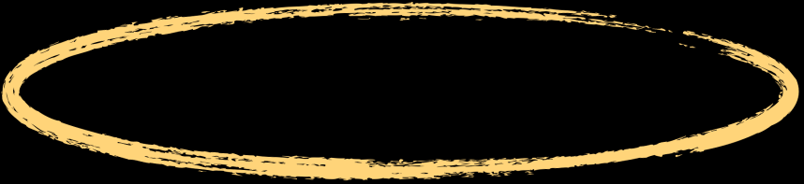
Stateless Token Validation On Edge
Deployment Workload
Verda-Common-Proxy
Nova
Notes:
Inside the verda, lots of verda infra service is developed with a cloud native proxy component that is called Verda-Common-Proxy as the sidecar container.
It is responsible for providing common verda proxy functionalities to each verda infra service in the form of plug-ins, such as API schema validation, audit logging, and Access Control. It does part of works that service mesh components did, like istio.

Slide 41
Stateless Token Validation On Edge
API Schema
ACL
Token Validation
Audit Log
Metrics
Notes:
For token validation feature, it's also one of common logics that is needed by each verda infra service. In that case, the VCP is the good choice to implement it as a middleware of pipline of request handling.

Slide 42
Keystone — Token Issue
Keystone — Original
Token Validation On Edge
Ingress
Token
Token
POST /v3/auth/tokens
Validation
decrypt
expiration check
Verda-Common-Proxy
Verda-Common-Proxy
Fernet Key
Verda-Common-Proxy
Issue
payload
Sign & encrypt
keystone
keystone
Nova / Neutron / VKS
Notes:
So, here is the desired workflow of stateless token validation in verda-common-proxy side
You can see, once two improvements are introduced
we can release original keystone service that includes the our custom business logic anytime without affecting authentication functionalities. Authentication logic will not be coupled with other logics
Each verda infra service can do the stateless token validation in verda-common-proxy side car side, without sending any request to keystone service.
It means
Even if original Keystone API is down, Token Verification / Issue still works
Even if original Keystone for token issue is down, Token Verification still works
3. When Token Verification Load increased by adding new Component, Verification Load Handling naturally scaled out together (thanks to side-car pattern)
4. When Token Issue Load increased, We can just scale out Token Issue functionality
5. When Keystone Release / Operation got issue, Token Issue API won’t be affected
”

Slide 43
Thank you
Notes:
That’s all I would like to share with you. Thanks for your listening
13min

